Slide 1
Patient’s Rights: confidentiality
Mohamed Hatta b Mohamed Tarmizi
SWACH

Slide 2


Confidentiality
Patients have the right to no disclosure of any personal information,
unless they give consent.
Covers
what a patient may reveal
what the practitioner may independently conclude or form an opinion about.
Notes:
The justification for this information being kept confidential is that it enhances the patientdoctor
relationship. Without assurances about confidentiality patients may be reluctant to
give doctors the information they need in order to provide good care.

Slide 3
Confidentiality
Confidentiality is an important duty,
A practitioner can disclose personal information if:
(a) it is required by law (paragraphs 15-20);
(b) the patient consents – either implicitly for the sake of their own care or expressly for other purposes; or
(c) it is justified in the public interest (paragraphs 34-48).
but it is not absolute.

Slide 4

Confidentiality
When disclosing information about a patient, the practitioner shall:
(a) use anonymised or coded information if practicable and if it will serve the purpose
(b) be satisfied that the patient:
(i) has ready access to information that explains that their personal information might be disclosed for the sake of their own care, or for clinical audit, and that they can object;
(ii) has not objected

Slide 5
Confidentiality
Get
get the patient’s expressed consent if identifiable information is to be disclosed for purposes other than their care or clinical audit, unless the disclosure is required by law or can be justified in the public interest
Keep
keep disclosures to the minimum necessary,
Keep up
to date with, and observe, all relevant legal requirements, including the common law and data protection legislation.

Slide 6
Discloser
When a practitioner is satisfied that information should be disclosed, the practitioner shall act promptly to disclose all relevant information.

Slide 7
Patient's rights
A practitioner shall respect, and help patients to exercise, their rights to:
(a) be informed about how their information will be used, and
(b) have access to, or copies of, their health records.

Slide 8
DISCLOSURES REQUIRED BY LAW
Disclosures required by statute
a known or suspected case of certain infectious diseases.
to investigate complaints, accidents or health professionals’ fitness to practise. or can be justified in the public interest

Slide 9
DISCLOSURES REQUIRED BY LAW
Whenever practicable, the practitioner shall inform patients about such disclosures, even if their consent is not required unless that would undermine the purpose.
1
Patient records or other personal information may be required by the MMC or other statutory regulators for an investigation into a healthcare professional’s fitness to practise.
2
if practicable, seek the patient’s expressed consent before disclosing personal information.
3
a patient refuses to consent, or not practicable to seek consent, contact the appropriate regulatory body, to help him or her decide whether the disclosure can be justified in the public interest
4

Slide 10
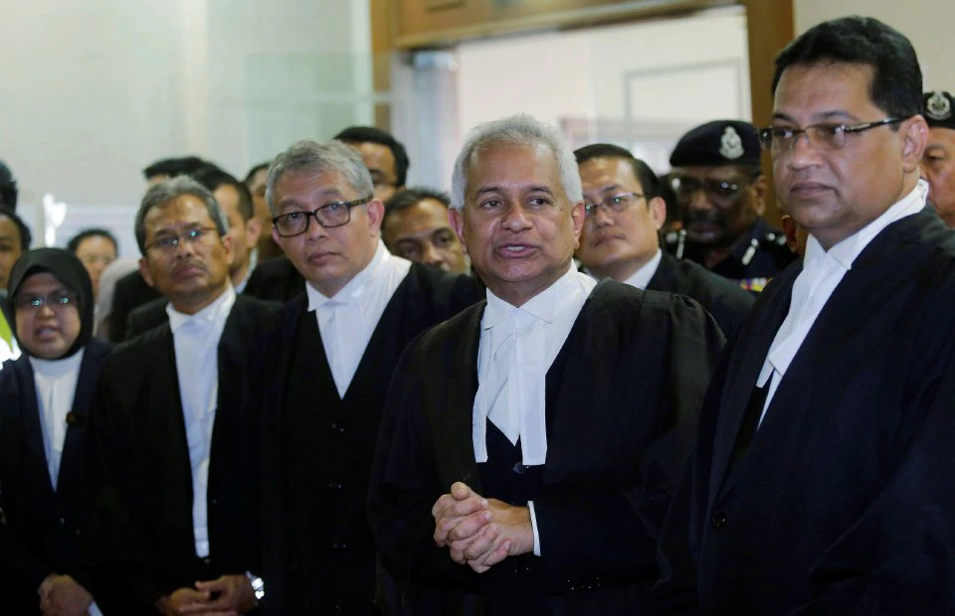
Disclosures to courts or in connection with legal proceedings
The practitioner shall disclose information if ordered to do so by a judge or presiding officer of a court.
The practitioner shall object to the judge or the presiding officer if attempts are made to compel him or her to disclose what appears to be irrelevant information,
not disclose personal information to a third party without the patient’s consent, unless it is required by law or can be justified in the public interest.
Notes:
such as information about a patient’s relative who is not involved in the
proceedings.
such as an
advocate or solicitor, police officer or officer of a court

Slide 11
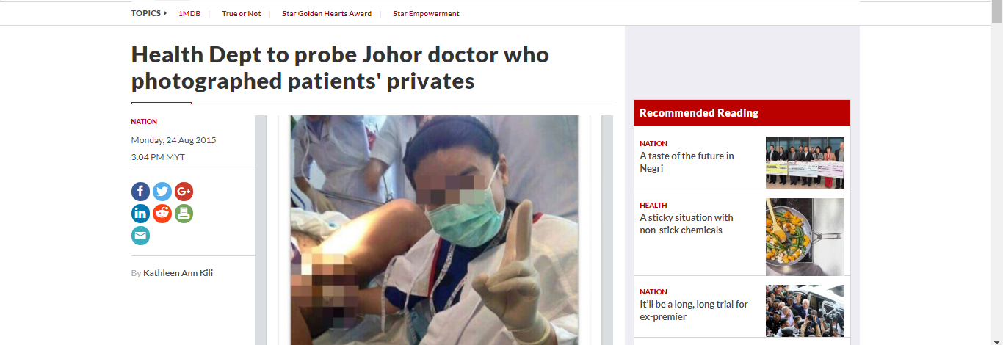
It is learnt that the doctor has been serving as a medical officer in the hospital near Taman Mount Austin here for the past three years and was known for taking selfies while at work in the operation theatre

Slide 12

PERLINDUNGAN KERAHSIAAN PESAKIT (MS)
Semua maklumat dan identiti pesakit di fasiliti kesihatan TIDAK BOLEH didedahkan melalui sebarang bentuk laman media sosial.

Slide 13

Media so-sial
memuat naik dan menyebarkan penghantar maklumat, data, rekod, audio, video dan visual yang berkaitan dengan identiti pesakit seperti
nama,
nombor pendaftaran,
nombor kad pengenalan dan alamat
(seperti yang terdapat di pengimbas ECG, keputusan makmal dan keputusan x-ray (radiological images), CTG, )
adalah salah di sisi undang-undang.

Slide 14

Written consent form
Kebenaran bertulis (menggunakan borang kebenaran) WAJIB diperolehi daripada pesakit apabila memuat naik dan menghantar maklumat, data, rekod, audio, video dan visual berkaitan pesakit.
Pengecualian hanya dibenarkan semasa dalam keadaan kecemasan di mana pesakit mungkin tidak dapat memberi persetujuan.

Slide 15

facebook
Anggota penjagaan kesihatan (kedua-dua penghantar dan penerima) TIDAK BOLEH menyebarkan maklumat yang berkaitan dengan pesakit atau apa-apa maklumat kesihatan kepada orang lain atau memuat naik apa-apa maklumat di mana-mana platform media sosial yang boleh di akses orang awam atau di akses oleh orang yang tidak berkaitan seperti di laman facebook
kerana ia adalah rahsia pesakit.

Slide 16

Delete it
Anggota penjagaan kesihatan (kedua-dua penghantar dan penerima) diminta untuk memadam semua penghantar maklumat, data, rekod, audio, video dan visual pesakit di peranti mudah alih mereka selepas rundingan/konsultasi selesai.

Slide 17
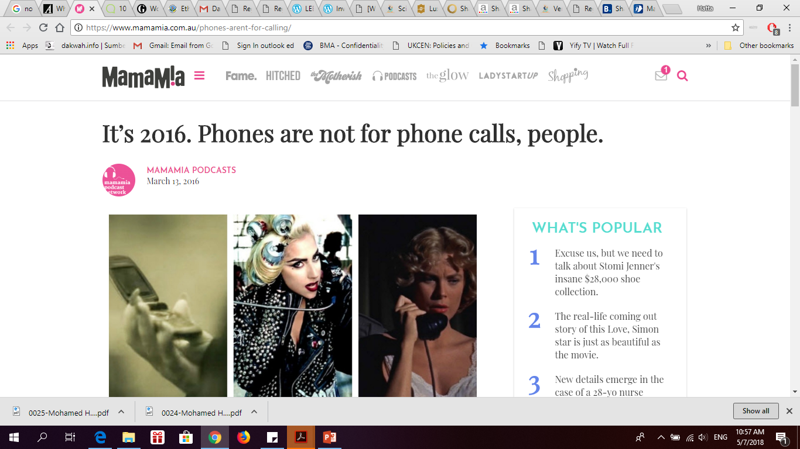

Perundingan / konsultasi bagi kes-kes kecemasan hendaklah dimulakan melalui telefon (jika ada) untuk anggota penjagaan kesihatan yang bertanggungjawab sebelum saluran media sosial digunakan bagi perbincangan kes selanjutnya, sekiranya perlu.

Slide 18
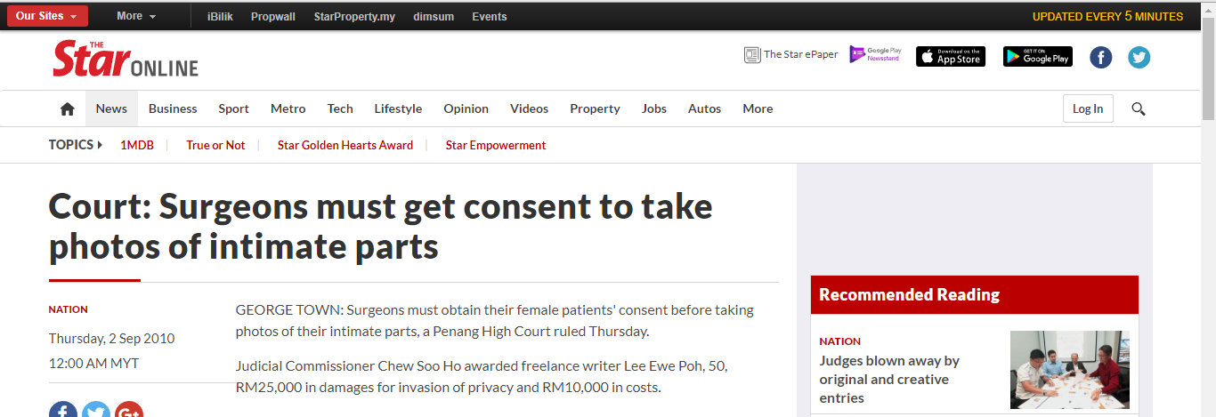
LEE EWE POH v. DR LIM TEIK MAN & ANOR HIGH COURT MALAYA, PULAU PINANG CHEW SOO HO JC [CIVIL SUIT NO: 22-170-2007]

Slide 19

SHARING INFORMATION WITH A PATIENT’S SPOUSE, PARTNER, CARERS, RELATIVES OR FRIENDS
The practitioner shall establish with the patient what information they want to share, who with, and in what circumstances.
Early discussions of this nature can help to avoid disclosures that patients would object to.
If anyone close to the patient wants to discuss their concerns about the patient’s health, the practitioner shall make it clear to them that, while it is not a breach of confidentiality to listen to their concerns, the practitioner cannot guarantee that the practitioner will not tell the patient about the conversation.
Notes:
The practitioner shall establish with the patient what information they want to share, who with, and in what circumstances. This will be particularly important if the patient has fluctuating or diminished capacity or is likely to lose capacity, even temporarily. Early discussions of this nature can help to avoid disclosures that patients would object to. They can also help to avoid misunderstandings with, or causing offence to, anyone the patient would want information to be shared with. If a patient lacks capacity, the practitioner shall share relevant information in accordance with the advice in paragraphs 49 to 53. Unless they indicate otherwise, it is reasonable to assume that patients would want those close to them to be kept informed of their general condition and prognosis. 56. If anyone close to the patient wants to discuss their concerns about the patient’s health, the practitioner shall make it clear to them that, while it is not a breach of confidentiality to listen to their concerns, the practitioner cannot guarantee that the practitioner will not tell the patient about the conversation. The practitioner might need to share with a patient,
Their views or the information they provide might be helpful in the care of the patient. The practitioner will need to take cognizance of whether the patient would consider the practitioner’s listening to the concerns of others about the patient’s health or care to be a breach of trust, particularly if they have requested the practitioner not to listen to certain people.

Slide 20
SHARING INFORMATION WITH A PATIENT’S SPOUSE, PARTNER, CARERS, RELATIVES OR FRIENDS
The practitioner might need to share with a patient, information which was received from others, for example, if it has influenced the practitioner’s assessment and treatment of the patient.
The practitioner shall not refuse to listen to a patient’s spouse, partner, carers or others on the basis of confidentiality.

Slide 21


DISCLOSURE AFTER A PATIENT’S DEATH
keep personal information confidential after a patient dies.
should consider requests for information taking into account: (a) whether the person requesting the information has locus standi; (b) whether the disclosure of information may cause distress to, or be of benefit to, the patient’s partner or family; (c) whether disclosure of information about the patient will in effect disclose information about the patient’s family or other people; (d) whether the information is already public knowledge or can be anonymised; (e) the purpose of the disclosure.

Slide 22
DISCLOSURE AFTER A PATIENT’S DEATH
There are circumstances in which a practitioner shall disclose relevant information about a patient who has died, for example: (a) to help a coroner or other similar officer in an inquest or fatal accident inquiry (b) when disclosure is required by law or is justified in the public interest, such as for education or research (c) for National Confidential Inquiries or for clinical audit (d) on death certificates, which the practitioner shall complete honestly and fully (e) for public health surveillance, in which case the information should be anonymised or coded, unless that would defeat the purpose (f) when a parent asks for information about the circumstances and causes of a child’s death.

Slide 23
MEDIA INQUIRIES ABOUT PATIENTS
Where such comment includes information about patients, the practitioner shall respect the patient’s right to confidentiality.
Before releasing any information, the practitioner shall:
(a) Remember that information which the practitioner has learnt in a professional capacity shall be regarded as confidential whether or not the information is also in the public domain
(b) Expressed consent shall be obtained from the patient before discussing matters relating to their care, with the media, whether or not the patient's name or other identifying information is to be revealed. Expressed consent shall be obtained if patient will be identified from the details disclosed.

Slide 24
MEDIA INQUIRIES ABOUT PATIENTS
(c) Remember that a patient can be identified from information other than name or addresses. Details which in combination may reveal a patient’s identity include their condition or disease, age, occupation, the area where they live, medical history or the family.
(d) Always consider and act in accordance with the best medical interests of patients when responding to invitations to speak to the media about patients.

Slide 25



conclusion
Patient’s confidentiality is a fundamental right to a person
Respect this right
Ensure patient’s safety
And your safety too

Slide 26
Thank you
Any questions?

